Slide 1
Faculty of Computer Science & Engineering
SecureSight
Smart Surveillance System to Detect
Unusual Activities in Real Time
Supervised by Dr. Essam Abdellatef

Slide 2


Slide 3
Introduction

Slide 4
Problem Statement

Slide 5
Motivation

Slide 6
Objectives

Slide 7
Requirements

Slide 8
Existing Solutions

Slide 9
Literature Review

Slide 10
Proposed Solution

Slide 11
Dataset Overview — UCF-Crime
14
9
128h
1,900
Original Classes
Merged Classes
Total Video
Surveillance Videos
Original 14 classes
Merged 9-Class Taxonomy
Abuse
Arrest
Arson
Assault
Burglary
Explosion
Fighting
Normal
RoadAccidents
Robbery
Shooting
ShopLifting
Stealing
Vandalism
Violence (Assault + Fighting + Abuse)
Theft (ShopLifting + Stealing + Burglary + Robbery)
Arson (Arson)
Explosion (Explosion)
Arrest (Arrest)
RoadAccidents (RoadAccidents)
Shooting (Shooting)
Vandalism (Vandalism)
Normal (Normal)

Slide 12
Data Collection Pipeline

Slide 13
Complete System Workflow
1

Slide 14
System Architecture

Slide 15
System Workflow

Slide 16
UML Diagrams

Slide 17
Technology Stack

Slide 18
Dataset

Slide 19
Data Preprocessing

Slide 20
Model Architecture

Slide 21
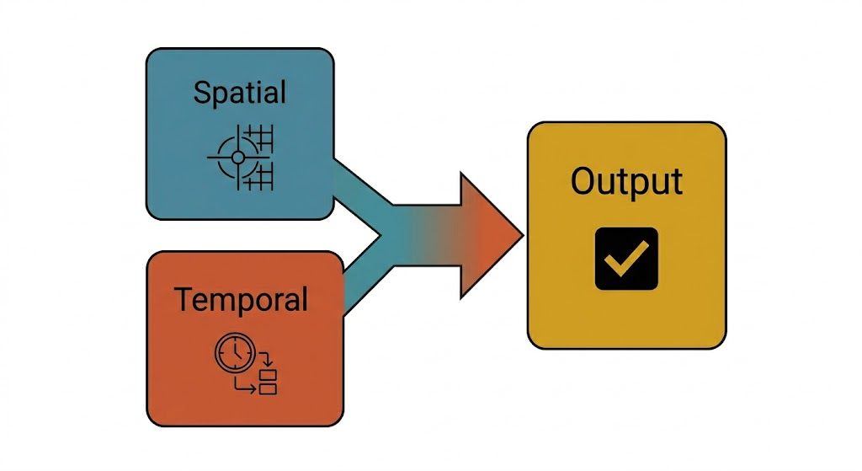
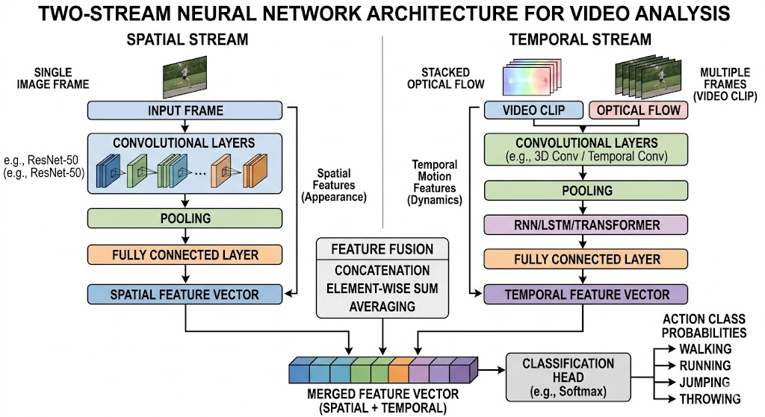
Two-Stream Architecture
Formulation:
Ffinal=Fuse(Fs,Ft)

Slide 22
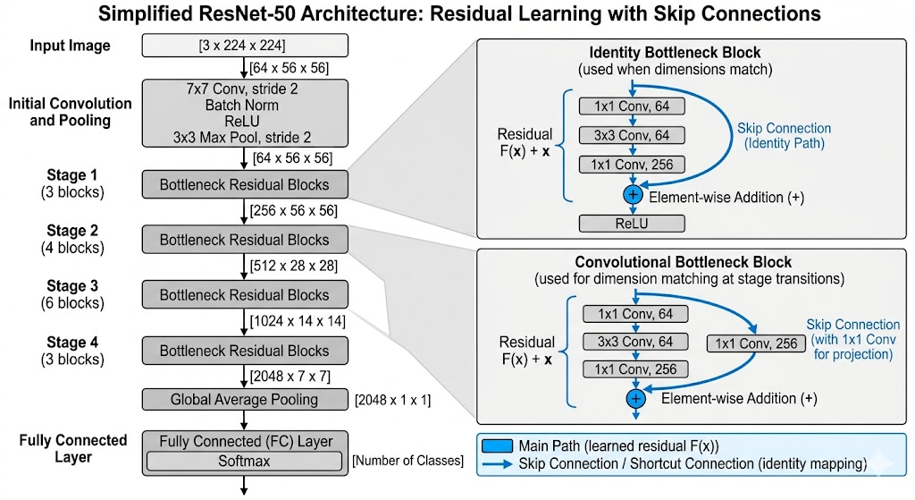
Spatial Stream (ResNet-50)
Spatial convolution:
Fs1 = f (Ws ∗ xt + bs)
Residual Learning:
Fs = F (Fs1 + xt)
Final Spatial Output:
Ys​ = f (Ws​ ∗ Xt ​+ bs​) + Xt​

Slide 23
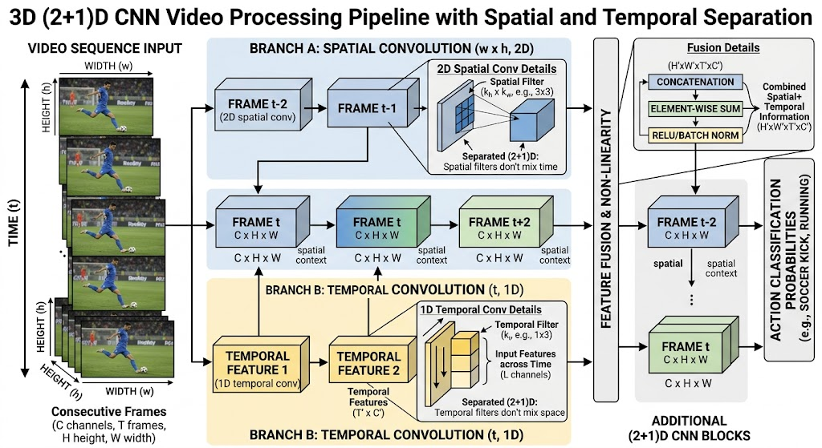
Temporal Stream (R(2+1)D)
Spatial convolution:
st= fs (Ws ∗ xt)
Temporal convolution:
Ft = ft (Wt * Fst + bt)
Residual Learning:
Yt = F (Fs1 + xt)
Final Spatial tOutput:
Ys​ = ft (fs (Ws​ ∗ X)​) + X​

Slide 24
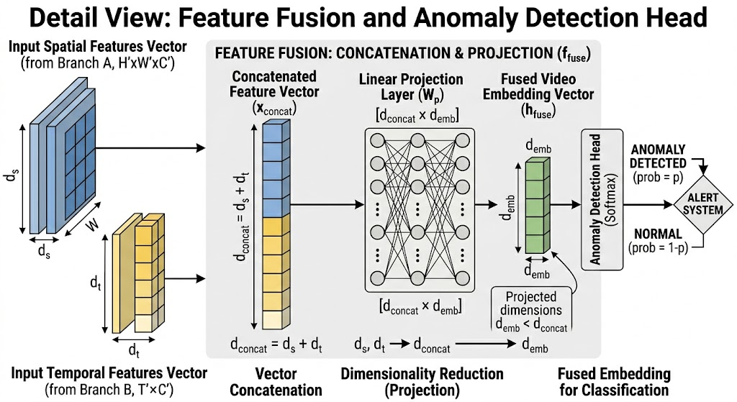
Feature Fusion
Equation (concatenation):
F = [Fs;Ft]
Then projection:
F′ = WF + b

Slide 25
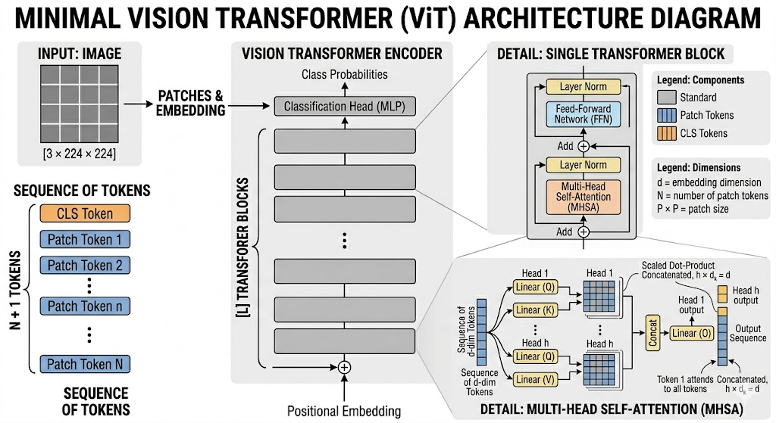
Vision Transformer (ViT)
Attention(Q,K,V)=softmax{Q*K(T​ranspose) / square root (d)}*V

Slide 26
Training Process

Slide 27
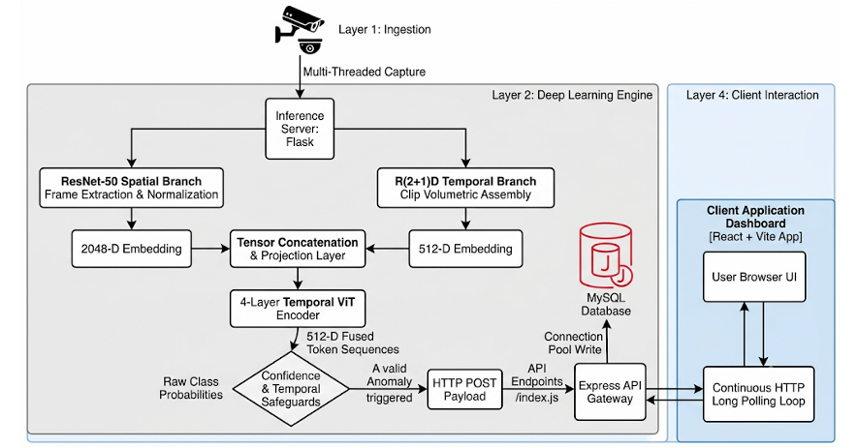
Implementation

Slide 28

Implementation

Slide 29
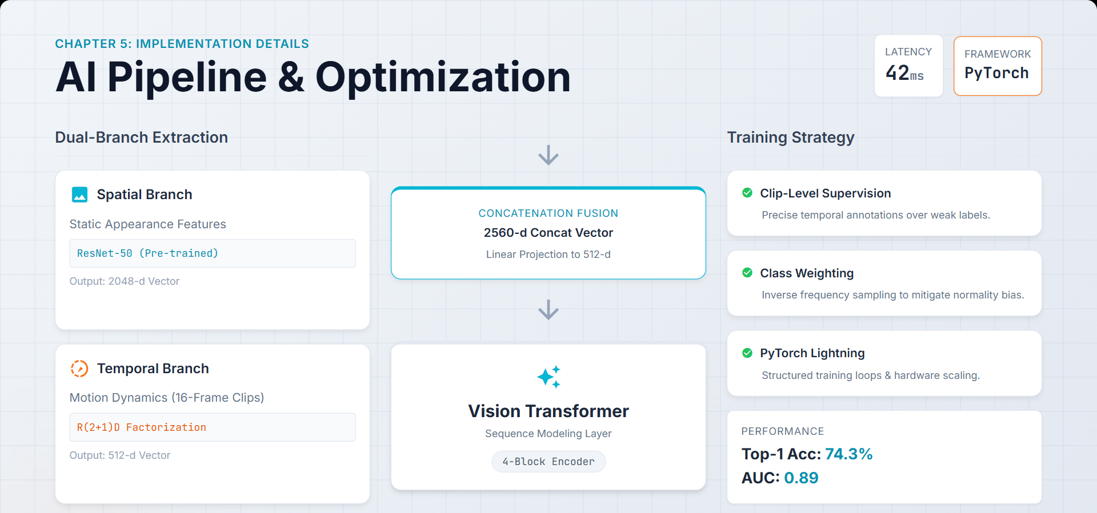
Implementation

Slide 30
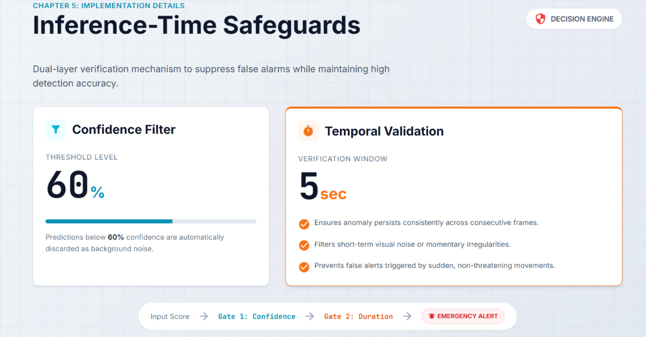
Implementation

Slide 31
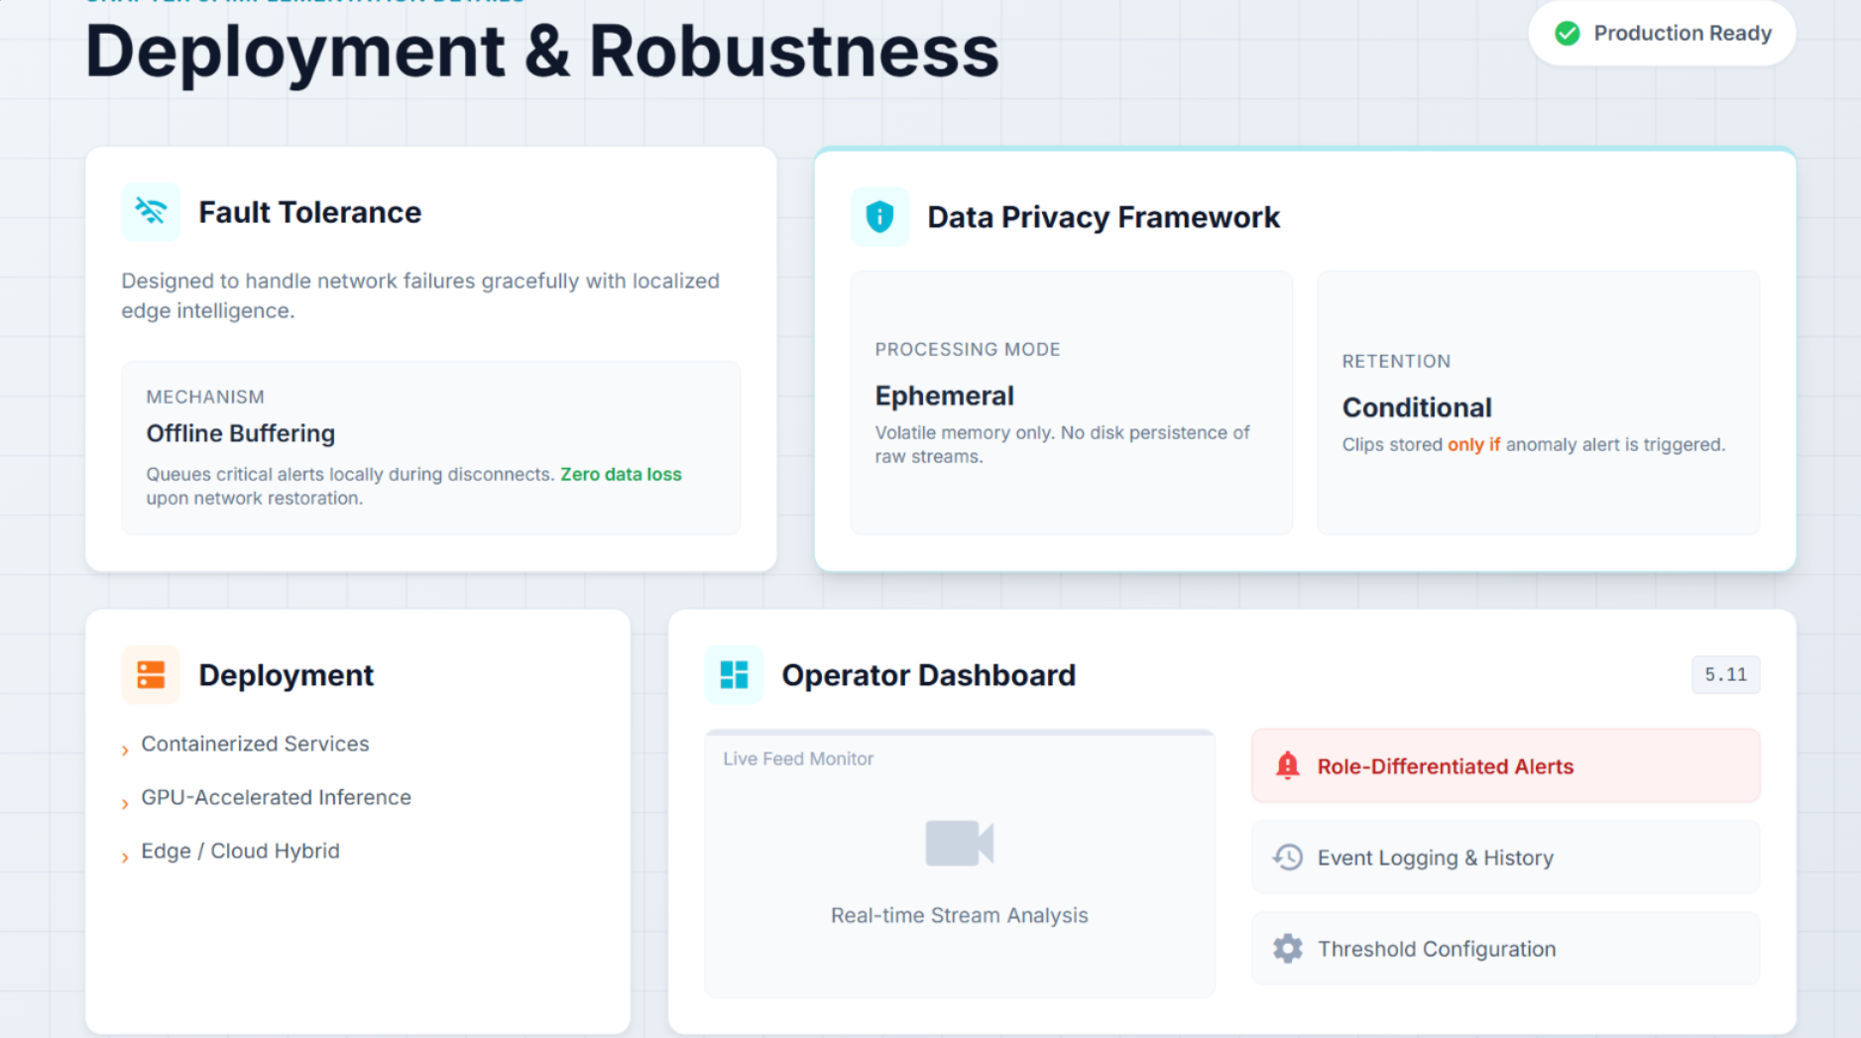
Implementation

Slide 32
System Integration

Slide 33
Results

Slide 34
Web Interface

Slide 35
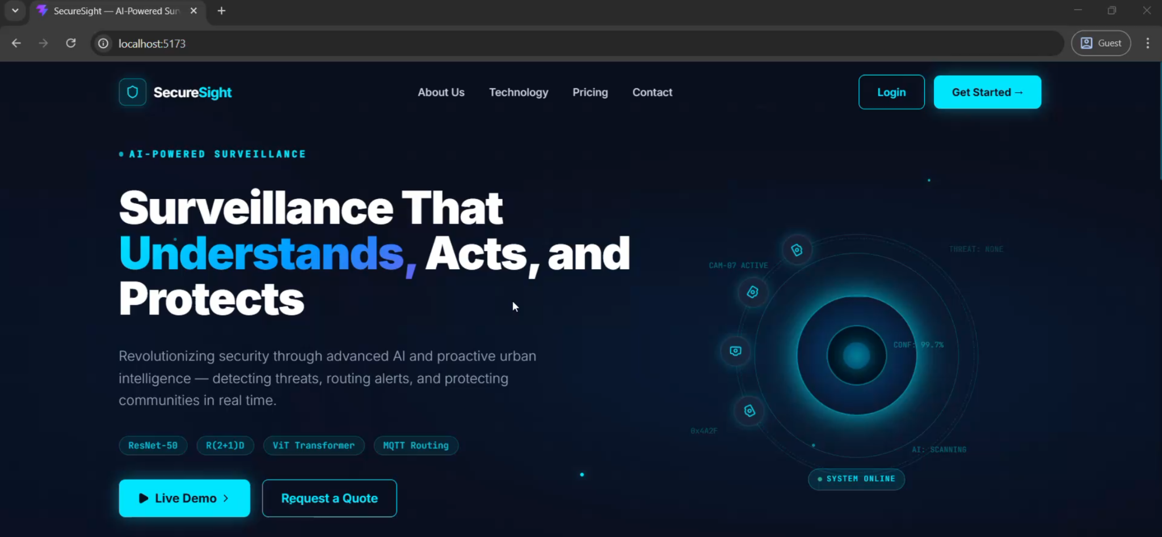
Web Interface
End-to-end working system
Real-time video analysis
Multi-class anomaly detection
Live alert visualization

Slide 36
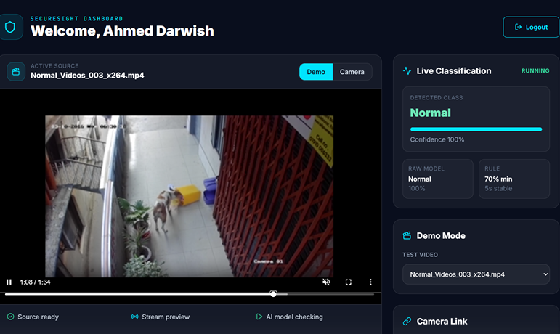
Web Interface
Input: CCTV / video footage
Model processes video stream
Detects anomaly in real-time
Displays confidence score
Triggers alerts

Slide 37
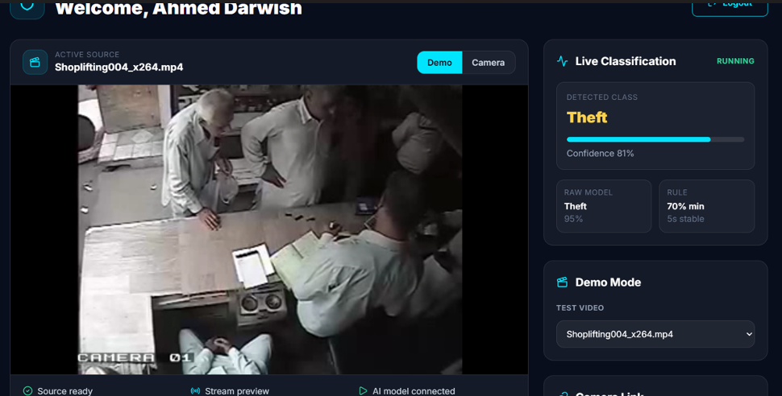
Web Interface
Input: CCTV / video footage
Model processes video stream
Detects anomaly in real-time
Displays confidence score
Triggers alerts

Slide 38
System Features&Demo

Slide 39
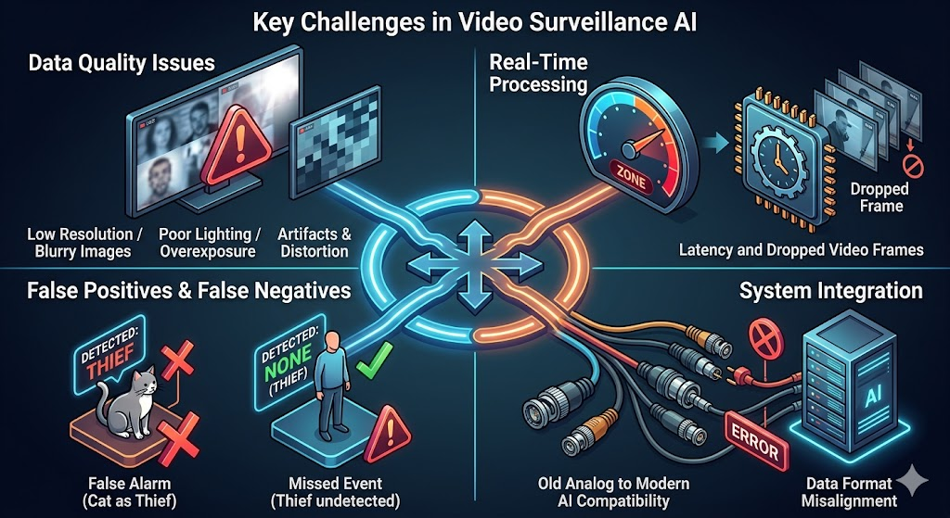
Challenges

Slide 40
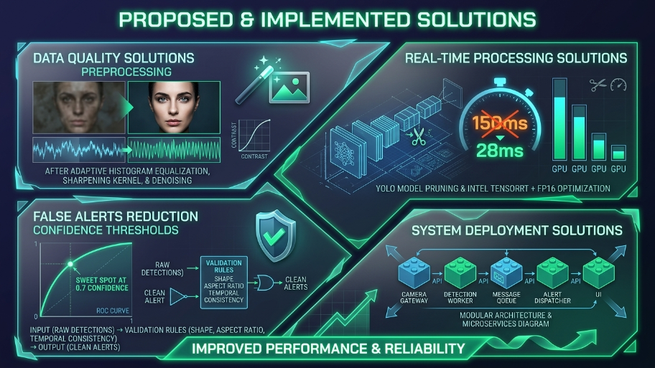
Solutions

Slide 41
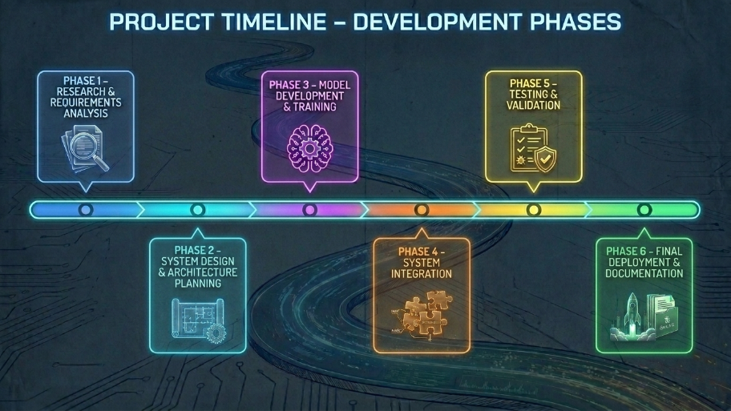
Project Timeline

Slide 42
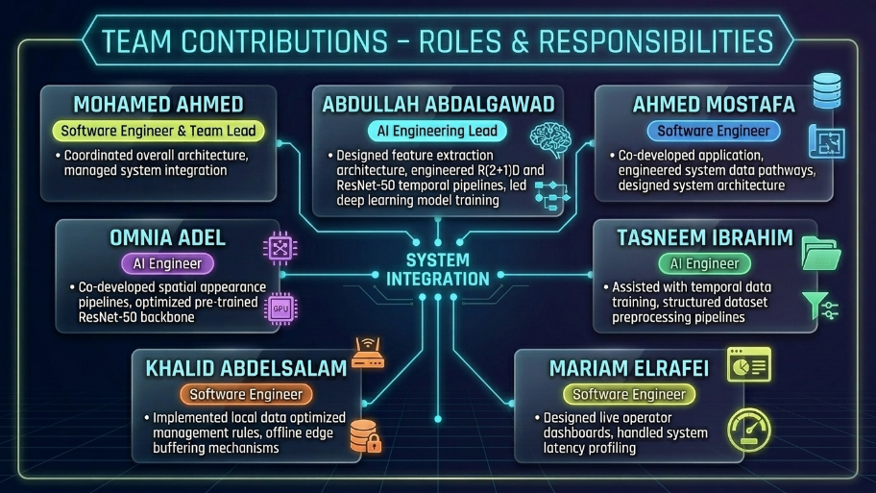
Team Contributions

Slide 43
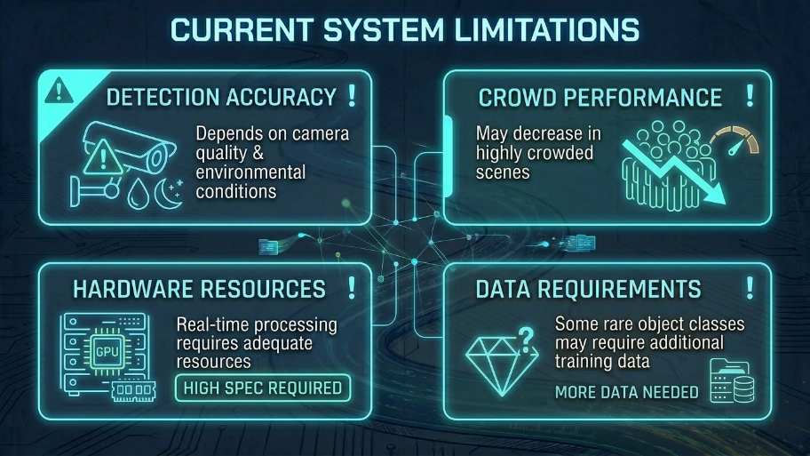
Limitations

Slide 44
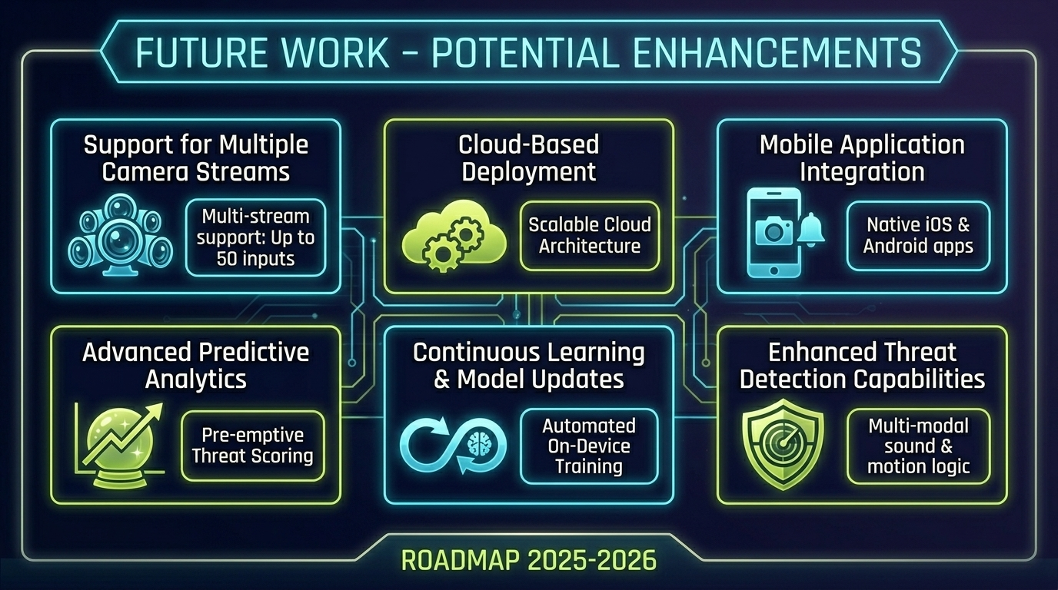
Future Work

Slide 45
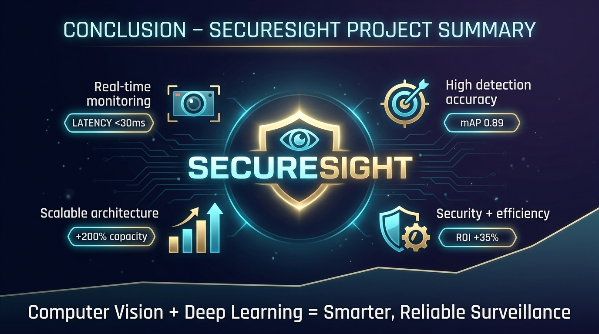
Conclusion

Slide 46
References
UCF-Crime Dataset – Sultani et al., CVPR 2018
UCA Annotation Dataset – Yuan et al., arXiv 2023
ResNet-50 – He et al., CVPR 2016
I3D – Carreira & Zisserman, CVPR 2017
R(2+1)D – Tran et al., CVPR 2018
Vision Transformer (ViT) – Dosovitskiy et al., arXiv 2020
Graph Convolutional Label Noise Cleaner – Zhong et al., CVPR 2019
RTFM Method – Tian et al., ICCV 2021

Slide 47
Q&A
.

